Slide 1
caMOD – Cancer Models Database
Version 2.5
VCDE Silver Compatibility Review
January 2009

Slide 2
Agenda
Vision
Overview
History
Changes since last review (caMOD 2.1)
Interoperability
UML Model
CDEs
Value Domains
Vocabulary Usage
Architecture
  Remote API
  Grid Data Service
Q & A

Slide 3
Preface
Cancer models that recapitulate many aspects of the
genesis
progression
clinical course of human cancers
are valuable resources to cancer researchers engaged in a variety of basic, translational, clinical, and epidemiological investigations.

Slide 4
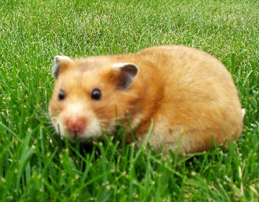
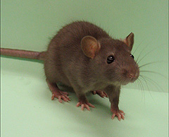
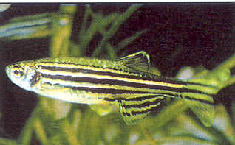
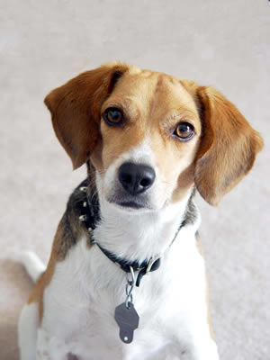

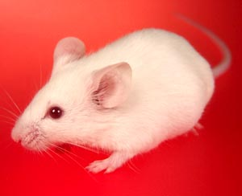
Vision
To create an application that allows cross-species comparison of animal model based experiments to aid in improving the outcome of clinical trials and eventually the treatment and care of all cancer patients.

Slide 5
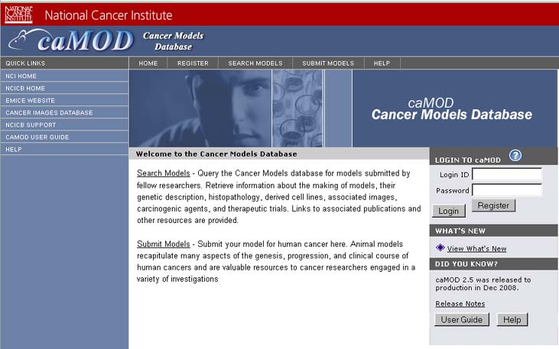
Cancer Models Database
  Submission--Data in caMOD are extracted from the public scientific literature by curators and verified by the scientists who generated or worked with the models, or they are directly submitted by scientists.
  Search--Users can retrieve information about the making of models, their genetic descriptions, histopathology, derived cell lines, associated images, carcinogenic interventions, microarray data, and therapeutic trials in which the models were used. caMOD provides links to PubMed for associated publications and other resources such as mouse repositories, detailed information about altered gene, pathway affected, and information about human clinical trials that utilize the same compounds as the pre-clinical trials in the animal models.
  System Function Administration-- The Admin function provides services for user registration, review of submitted models and database management.
  The cancer models database (caMOD) is a web-based resource that provides information about animal models for human cancer to the public research community

Slide 6
History
January 2000
  Prototype is presented during the Mouse Models of Human Cancers (MMHCC) Steering Committee Meeting
  MMHCC adopts the Cancer Models Database (caMOD) as one of their initiatives
July 2000
  NCICB assumes responsibility for caMOD
Spring 2001
  caMOD 1.0 released (2-tier application)
2001 – 2005
  Based on user feedback the application is constantly updated and improved.
December 2005
  caMOD 2.0 released (n-tier application, based on caBIG compliance guidelines)
May 2006
  caMOD 2.1 released
November 2006
  caMOD 2.2 released
September 2007
  caMOD 2.3 released
February 2008
  caMOD 2.4 released
December 2008
  caMOD 2.5 released

Slide 7
Since we last talked …
(Releases 2.3 – 2.5)
Customization of the application for rat and zebrafish models by introducing species-specific vocabularies and links to outside resources
Integration with caELMIR (caELMIR data are dynamically displayed on the therapeutic approaches page of models used in preclinical studies)
Technology Stack Upgrades
Reengineering of the search functionality
Improvements to the submission and search results pages
Gridification
Object Model changes as a result of the VCDE silver level compliance review:
  Introduction of a gene object to comply with the gene identifier standard
  Rename UnctrlVocab items to AlternEntry
  Rename Graft object into Transplantation object
  Add Comments attributes to every object that corresponds with a submission page
  Connect availability of model to person to resolve the available from investigator issue

Slide 8
Interoperability
caMOD has been designed, architected and constructed to facilitate interoperability with other systems, following caBIG guidelines.
Information Providers to caMOD:
  caBIO to retrieve gene info and clinical trials info through remote API
  EVS to provide concept codes and preferred descriptions for concepts through caBIO EVS API
  PubMED
  caELMIR
  Jackson Laboratory Resources
  Rat Genome Database
  ZFIN –Zebrafish Model Database
  NCI’s Developmental Therapeutics Program
  caArray to store microarray data
  caIMAGE server to store images
  Other sites that store microarray or image data

Slide 9
Interoperability
caMOD has been designed, architected and constructed to facilitate interoperability with other systems, following caBIG guidelines.
Information Consumers: caMOD provides information to other systems
  CMAP
  Websites such as eMice references specific models in caMOD
  caELMIR
  caNanoLab (future)
  CAPR (future)
  TP53 database at IARC in France (http://www-p53.iarc.fr/)

Slide 10
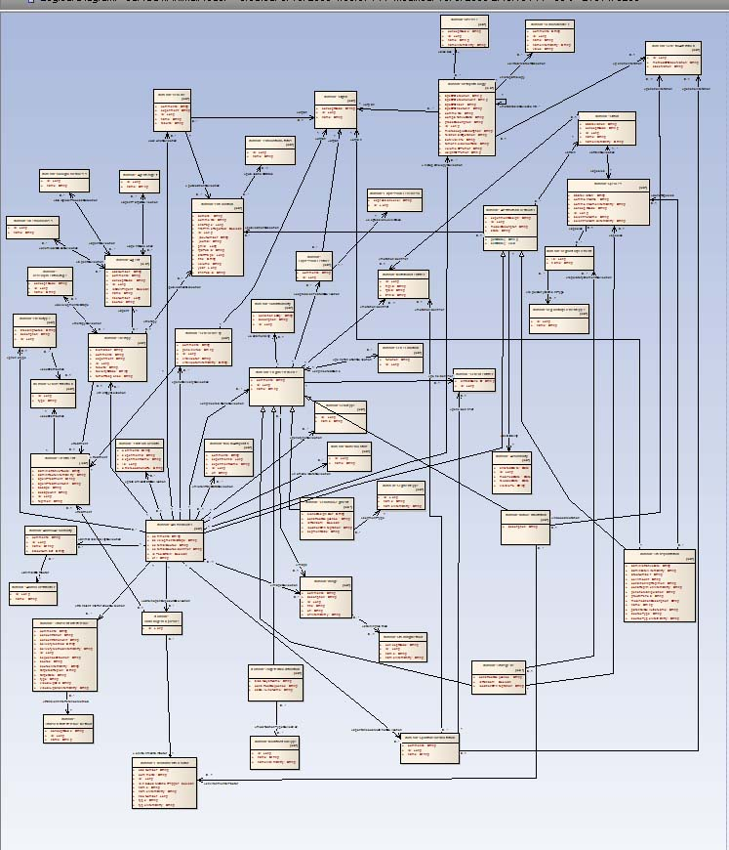
UML Model
65 Domain objects with 300 attributes categorized under
  caMOD::AnimalModel
  caMOD::CancerModel
  caMOD::InVivoModel (Xenograft)
  caMOD::YeastModel
EVSTree utilizes caBIO 3.2 API (currently upgrading to EVS 4.x and caBIO 4.x)

Slide 11
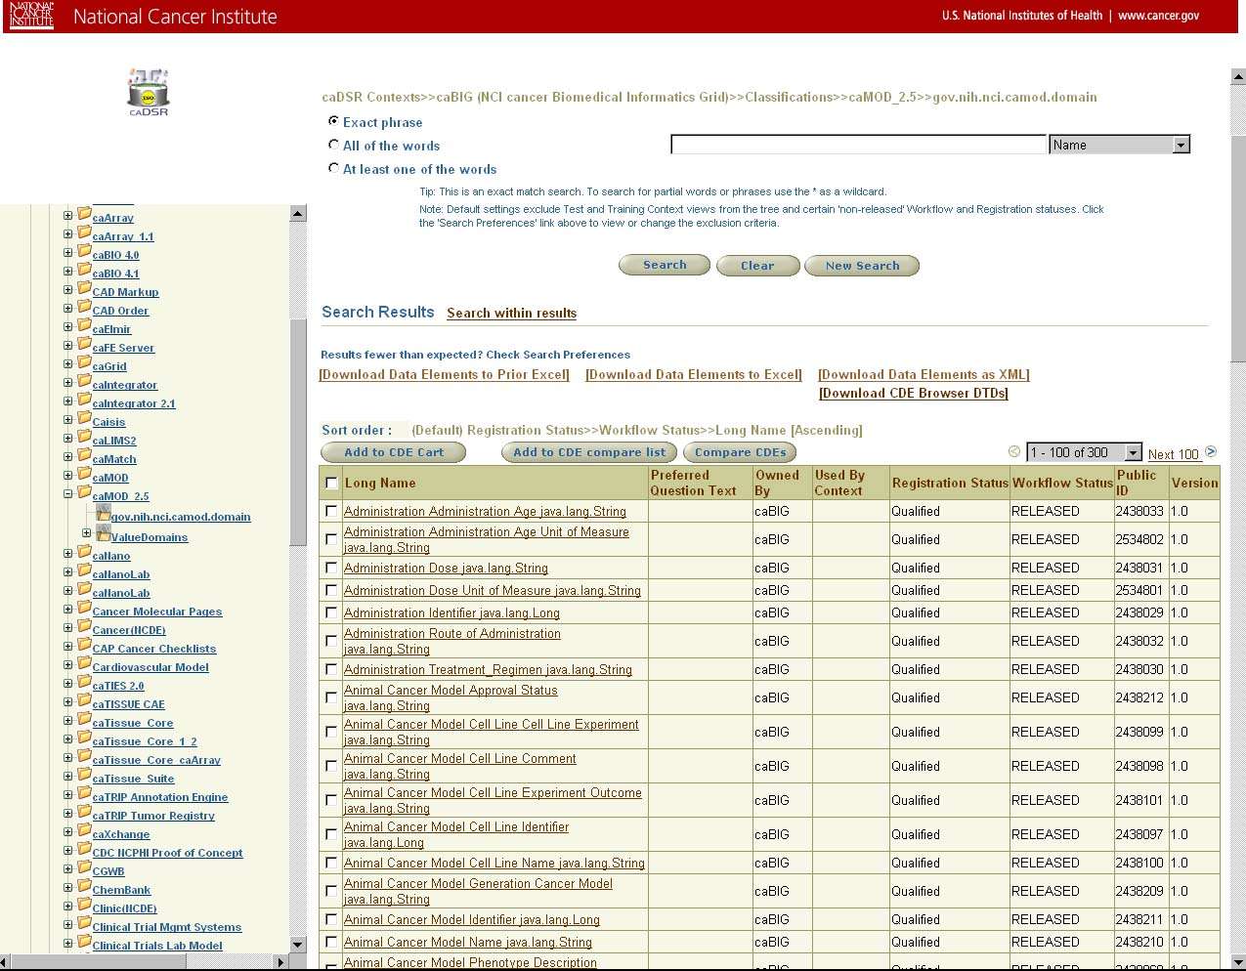
Common Data Elements
CDEs for caMOD 2.5 have been loaded into caDSR

Slide 12
Value Domains
AnatomicalTermCode - VD for Organ.conceptCode
AnatomicalTermName – VD for Organ.name
DiagnosticTermCode – VD for Disease.conceptCode
DiagnosticTermName – VD for Disease.name
StainingMethodCode – VD for StainingMethod.conceptCode
StainingMethodName – VD for StainingMethod.name
ZebrafishDevelopmentalStageCode – VD for DevelopementalStage.conceptCode
ZebrafishDevelopmentalStageName – VD for DevelopmentalStage.name

Slide 13
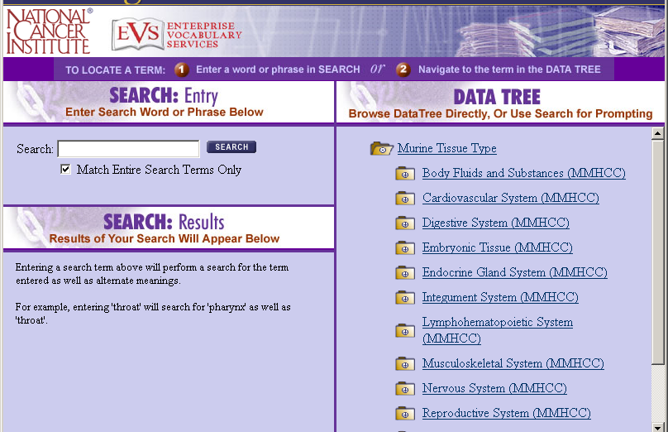
Vocabulary Usage
Murine Tissue Types (NCI Thesaurus)
Mouse Diagnoses (NCI Thesaurus)
Rat Anatomy (NCI Thesaurus)
Rat Diagnoses (NCI Thesaurus)
Human Anatomy (NCI Thesaurus)
Zebrafish Anatomy (EVS, outside NCI Thesaurus)
Zebrafish Developmental Stages (EVS, outside NCI Thesaurus)
Staining Methods (NCI Thesaurus)
EVSTree – Reusable component
for rendering EVS concepts

Slide 14
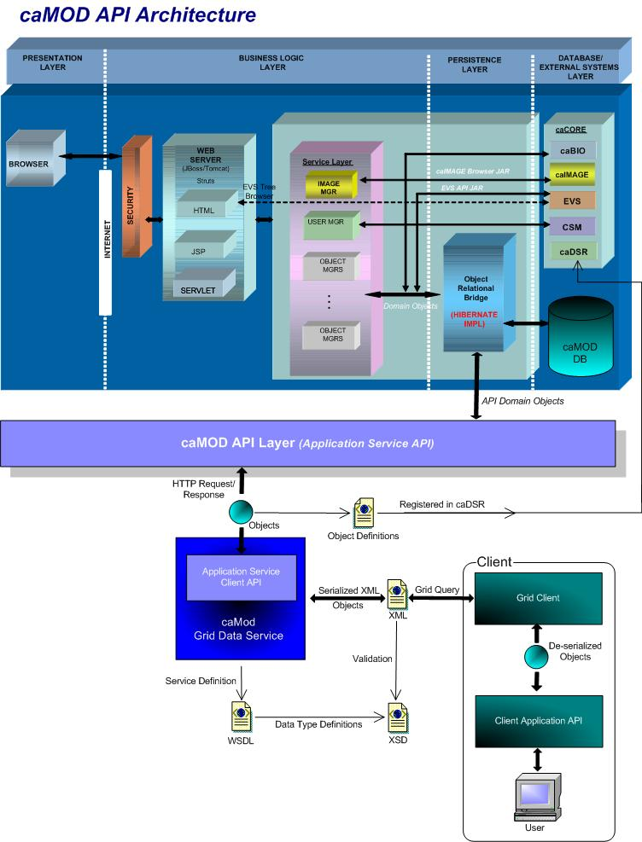
Architecture

Slide 15
caMOD API (Remote)
Using the caCore SDK Toolkit (version 4.0), an external caMOD API Layer was built upon the existing caMOD domain objects represented in the UML model.
Features of the caMOD SDK Generated System (CamodSDKClient):
Remote Java client
Query By Example (QBE) Interface
Seamless navigation of data source
Integration with caGrid tools

Slide 16











Generated System
Core Services
Registered in
Registered in
Semantically described with terminology from
Object
Definition
WSDL
XSD
Map to
Service Definition
Validate against
SDK Service
Generated by Introduce
SDK Service API
SDK Client API
Grid Service
Grid Client API
Client App
Oracle
Database
Objects
Java API
Reads
XML
Objects
MySQL
Database
Objects
Java API
Reads
Objects
Client uses
Service Definition
WSDL
XSD
Validate against
Web Service
Client uses
CSM
Security
Database
XML
Checks
Internet Browser
HTTP/REST
XML/ HTML

Slide 17
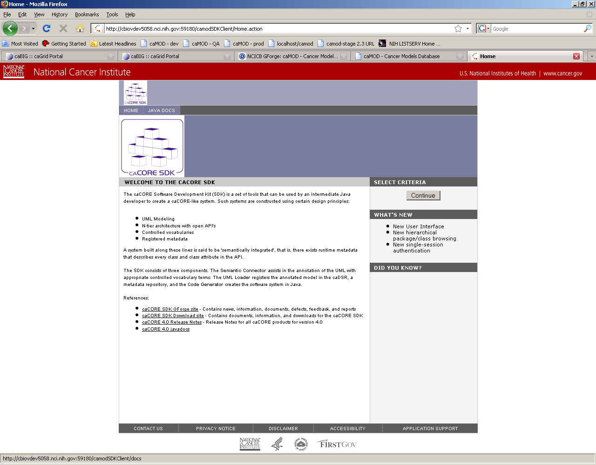
SDK Generated System – HTTP Interface

Slide 18
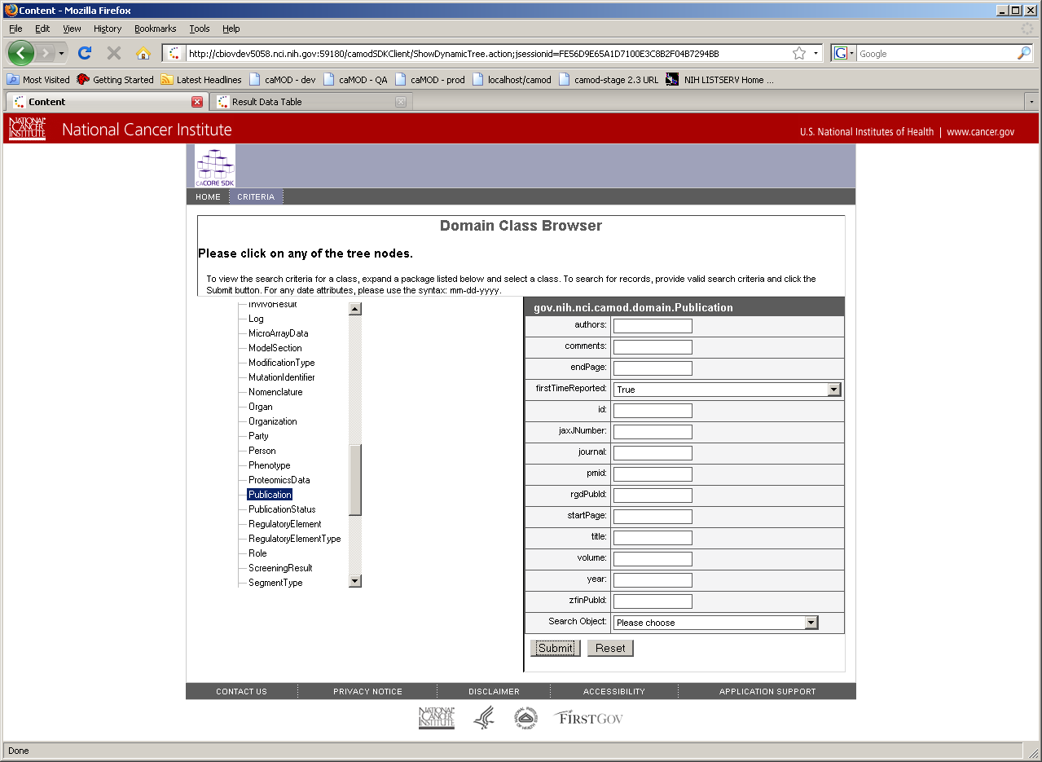
SDK Generated System – HTTP Interface

Slide 19
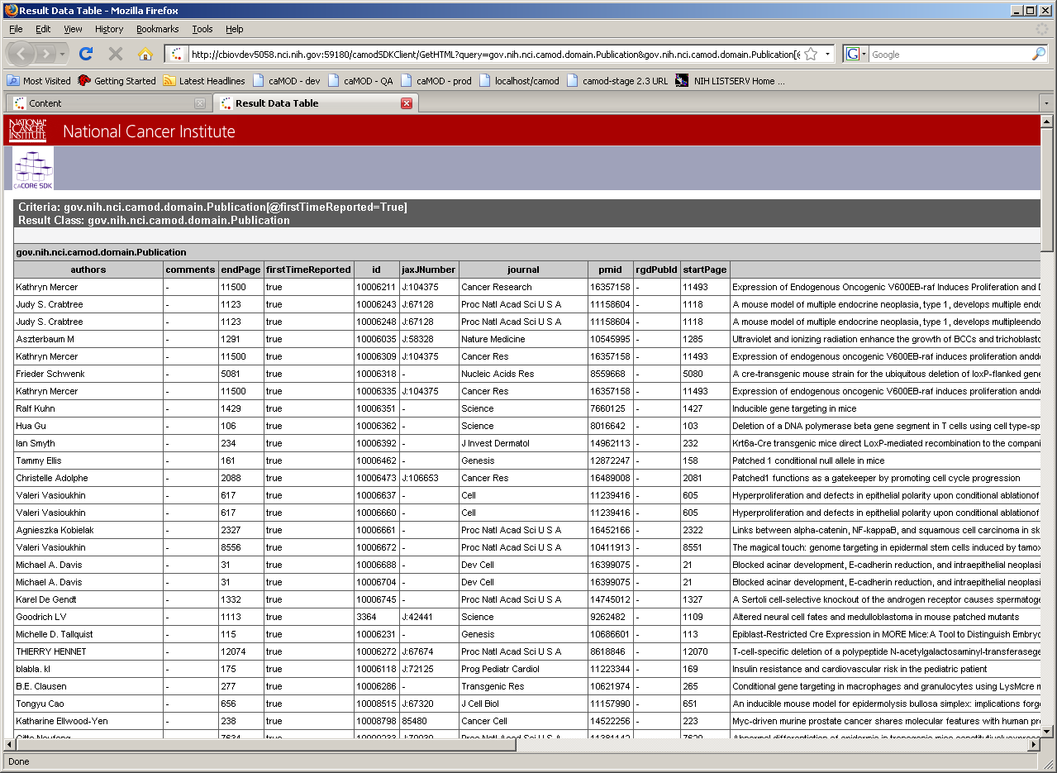
SDK Generated System – HTTP Interface

Slide 20
Example of external caMOD remote Java API
For the Publication class defined in caMOD we can query based on properties of the object as follows.
ApplicationService appService = ApplicationServiceProvider.getApplicationService();
try {
Publication thePublication = new PublicationImpl();
thePublication.setFirstTimeReported(“True");
List thePublications = appService.search(Publication.class, thePublication);
for (Iterator theIterator = thePublications.iterator(); thePublications.hasNext();)
{
Publication thePublication = (Publication) theIterator.next();
System.out.println(“Authors: " + thePublication.getAuthors() + "\tComments:" +
thePublication.getComments() + ……… ………………………….");
}
  }
  catch (Exception e) {
  e.printStackTrace();
  }
The result List of records will include all Publication objects whose firstTimeReported property is equal to “True”.

Slide 21
caMOD Grid Node
The caMOD Grid Data Service node was generated using the caGrid Toolkit (version 1.2).
The Data Type Definitions extracted from the caDSR registered caMOD model are used to build an XML schema or XSD that is used to define the input and output data types of the Grid services.
The XSD is registered in the Global Model Exchange (GME) and used to describe the contract of the grid service and to validate the XML serialization of the API Domain Objects during data requests.
Applications communicate with the caMOD Grid Data Service node following the caGrid services protocol.
The caMOD API domain objects are serialized/deserialized by the caMOD Grid Data Service to and from XML adhering to the XML Schema (XSD) that is registered in the Global Model Exchange (GME)
Integration of the caMOD application into the caGrid infrastructure includes the deployment of the caMOD Grid Data Service node and registration to the caBIG Index Service.

Slide 22
caGRID Demo
http://cbiovdev5058.nci.nih.gov:59180/wsrf-camod/services/cagrid/CamodGridService
<ns1:CQLQuery xmlns:ns1="http://CQL.caBIG/1/gov.nih.nci.cagrid.CQLQuery">
<ns1:Target name="gov.nih.nci.camod.domain.Therapy">
<ns1:Group logicRelation="AND">
<ns1:Attribute name="id" predicate="EQUAL_TO" value="50052631"/>
</ns1:Group>
</ns1:Target>
</ns1:CQLQuery>

Slide 23
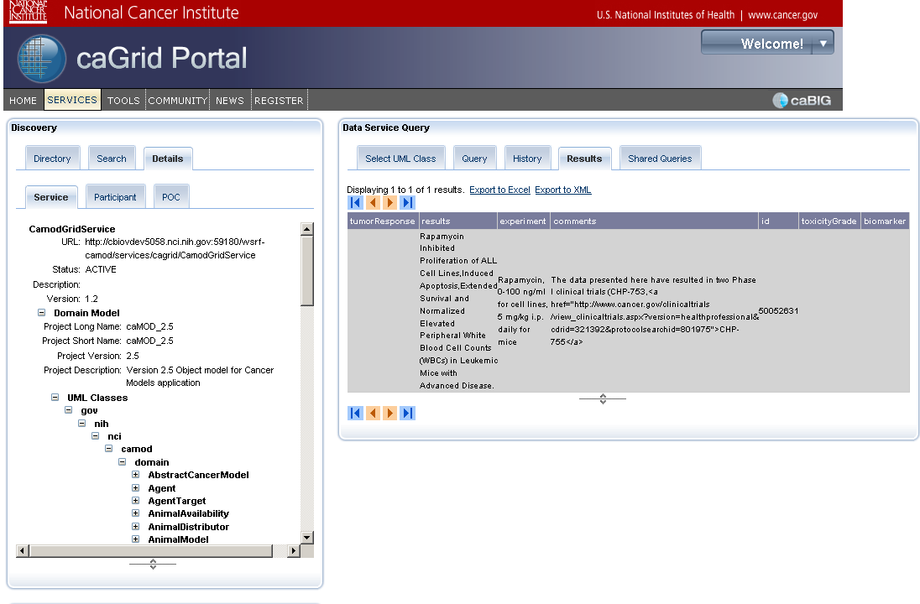
caGRID Demo
Results:

Slide 24
Q&A
Questions?

